Slide 1

Economies of Scale

Slide 2
Lesson Objective
By the end of this lesson all students should be able to develop their knowledge and understanding of Economies of Scale, diseconomies of scale and the growth of firms through Integration.

Slide 3
What is Economies of scale?
Economies of scale occur when the average costs of running a business fall as a firm increases its output and size.

Slide 4
Example
If I buy ingredients to bake 1 cake it will cost £4.
If I bake a second or third cake I will be able to use ingredients already bought so the average cost of the cake decreases.

Slide 5
Average Cost
Average Cost =
Total Cost
Number Produced

Slide 6
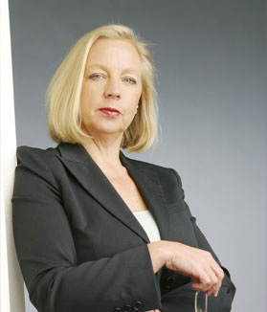


Experts in the business world including Deborah Meaden, Lord Sugar and Hugh Pym explain what Economies of Scale are and why they are essential to a successful business.
http://www.bbc.co.uk/learningzone/clips/economies-of-scale/10967.html

Slide 7
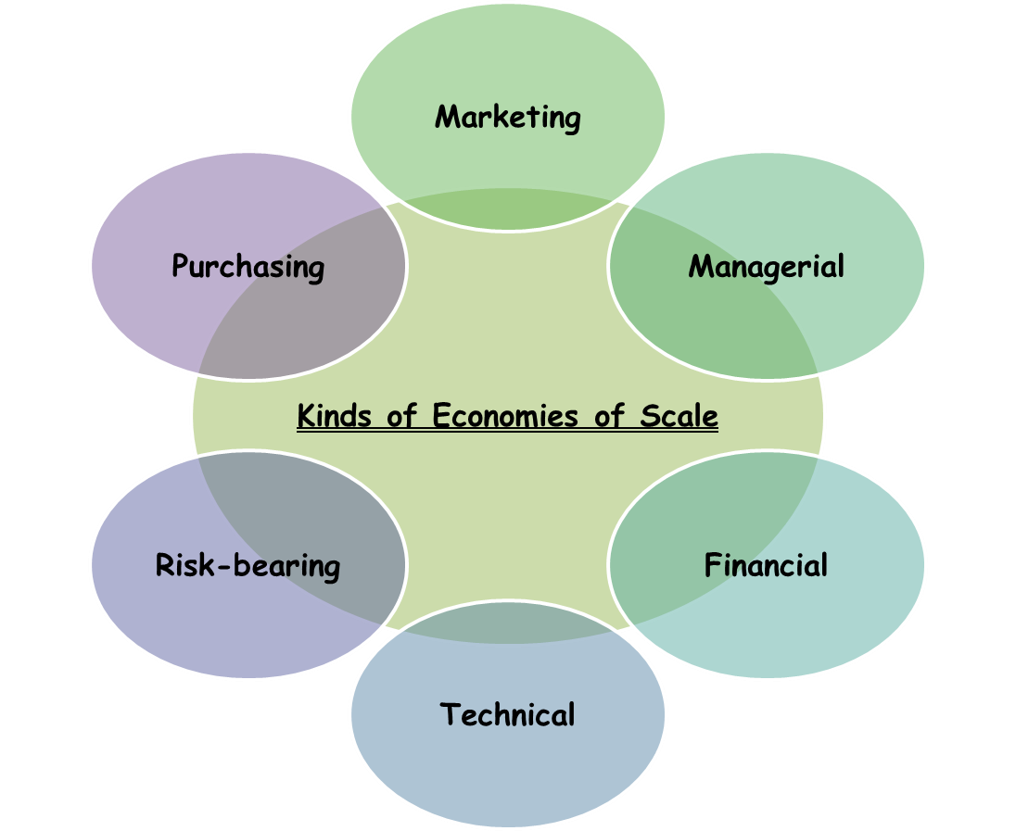
Internal Economies of scale

Slide 9
Occurs when a business invests in new technology and is able to increase production. As a result, production costs per unit will fall.
Occurs when a business produces a range of products, which means it is not dependant on just one product.
Occurs when a large firm can employ specialist workers to complete tasks and can spread the cost
Occurs when a business buys goods in bulk and benefits from discount.
Occurs when a large business can borrow money at a lower rate of interest than a smaller business
Occurs when a business grows and the average cost of advertising per unit falls

Slide 10
Occurs when a business buys goods in bulk and benefits from discount.
Occurs when a large firm can employ specialist workers to complete tasks and can spread the cost
Occurs when a business grows and the average cost of advertising per unit falls
Occurs when a large business can borrow money at a lower rate of interest than a smaller business
Occurs when a business invests in new technology and is able to increase production. As a result, production costs per unit will fall.
Occurs when a business produces a range of products, which means it is not dependant on just one product.

Slide 11
Internal
Economies
External
Economies
Technical
Purchasing
Financial
Managerial
Risk bearing
Marketing
Location
Skilled Labour
Transport
Reputation of Area

Slide 12
Diseconomies of Scale
The opposite of an economy of scale is a diseconomy of scale.
Diseconomies of scale occurs when
Average Costs start to rise with increased output.

Slide 13
How do firms grow?
3 main ways
Merging – two or more firms join together to become one.
Take over – when a firm buys control of another
Internal expansion – increasing production from inside business

Slide 14
Flour Miller A
Backwards Vertical Integration
Wheat Farmer
Diversification
Purchases a Perfume manufacturer
Forwards Vertical Integration
Bakery
Horizontal Integration
Flour Miller B
OCR Textbook page 125

Slide 15
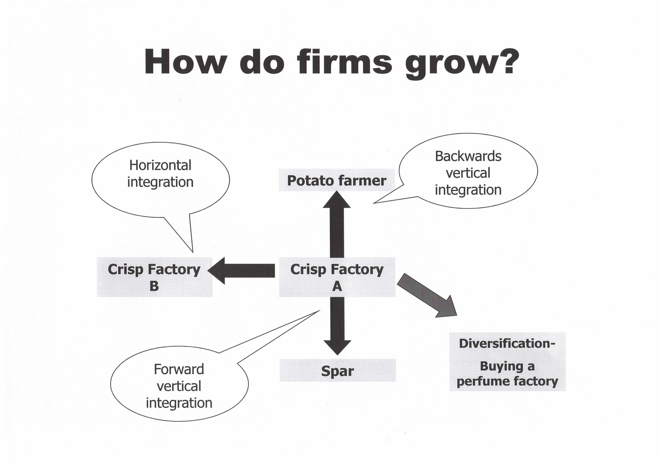

Slide 16
Extra Activity
http://www.dineshbakshi.com/igcse-business-studies/production/interactive-quizzes/1175-economies-of-scale-gap-fills

