Slide 1

Recruiting
&
Training staff

Slide 2

Aims for today
Consider the process by which small businesses recruit and select staff.
Appreciate the various laws relating to R&S (recruitment and selection).

Slide 3

Recruitment and selection
Recruitment and selection is the process of identifying the need for a job, defining the requirements of the position and the job holder, advertising the position and choosing the most appropriate person for the job.

Slide 4


The recruitment process
Recruitment is one of the main objectives of management as the success of any business depends to a large extent on the quality of its staff.
Recruiting employees with the correct skills can add value to a business. Employees should therefore be carefully selected, managed and retained, just like any other resource.

Slide 5
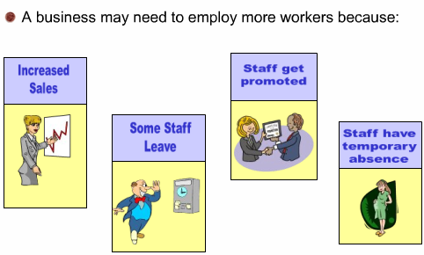
Why recruit?

Slide 6
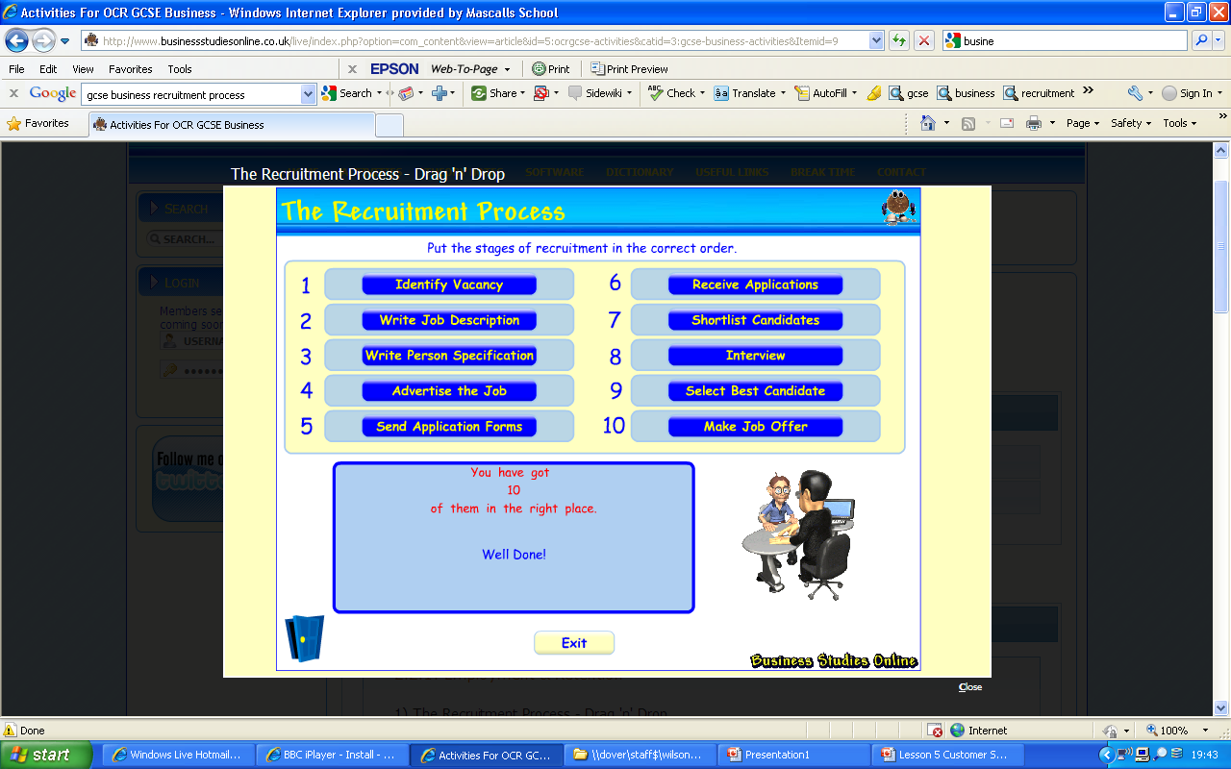

The Recruitment Process - solution

Slide 7
Documents in the recruitment process
Job Advert – a brief description of the job & skills needed.
Job description – A document describing the duties of a worker and his/her status in the firm.

Slide 8
Documents in the recruitment process
Personal specification – A profile of the skills and qualities of a person needed to do the job.
CV’s (Curriculum Vitae) – Summary of one’s education, skills, employment and experience. Application form – The form which the applicant fills in with their personal details

Slide 9
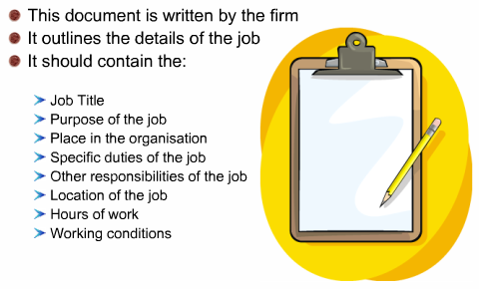
Job description

Slide 10
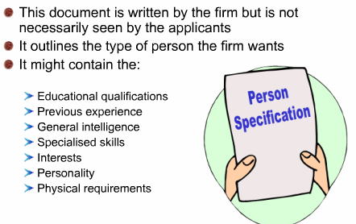
Personal Specification

Slide 11

Task 2: Skills employers look for
There are 10 key attributes that employers seek in their staff. In your groups, see if you can identify them...

Slide 12

Skills employers look for –
The 10 key attributes
Skills | Description
Communication | Written, verbal and presentation skills
Teamwork | Team player with ability to manage others
Negotiation & persuasion | Being able to get ‘your own way’ but understanding other perspectives
Problem Solving | Analysis & logical thinking
Leadership | Motivating a team, assigning tasks and meeting deadlines

Slide 13
Skills employers look for –
The 10 key attributes
Skills | Description
Organisation | Prioritising workload and time
Ability to meet deadlines | Efficiency and time management
Ability to work under pressure | Calm in a crisis, not becoming stressed
Confidence | In yourself, colleagues and the company
Commercial awareness | Knowing what makes a company tick

Slide 14

Bob the baker!
Bakin’ Buddies are looking for a new baker for their doughnut factory. What skills will he need to have?

Slide 15
Advertising the job – where?
Ad
Job centres
Internally
Internet
Newspaper & magazines
Trade journals

Slide 16
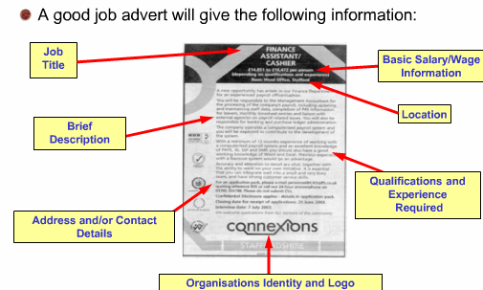
What should the ad say?

Slide 17

Task 3: Create a job advert
Choose 1 of the following 4 jobs and create an effective job advert
- You have 20 minutes -
Marketing executive
Business Studies Teacher
Small Business Advisor
Human resource Manager

Slide 18
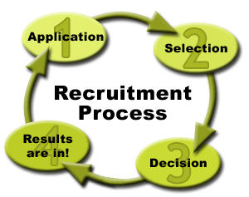
Selection
Once a job has been advertised and details sent out to prospective employees, the applicants will return their CV/Job applications.
The SELECTION process can begin...

Slide 19
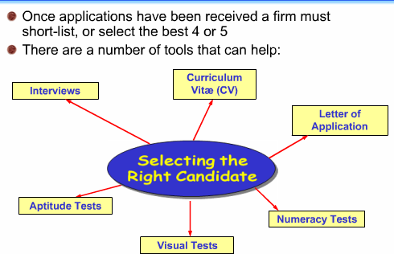
How do firms select?

Slide 20

What happens next?
A candidate is selected and a job offer is made.
A firm then asks for references – what the referees write is confidential and must be accurate.
Assuming references are ok – the candidate will start work.
Within 13 weeks of employment they must receive a CONTRACT OF EMPLOYMENT.

Slide 21
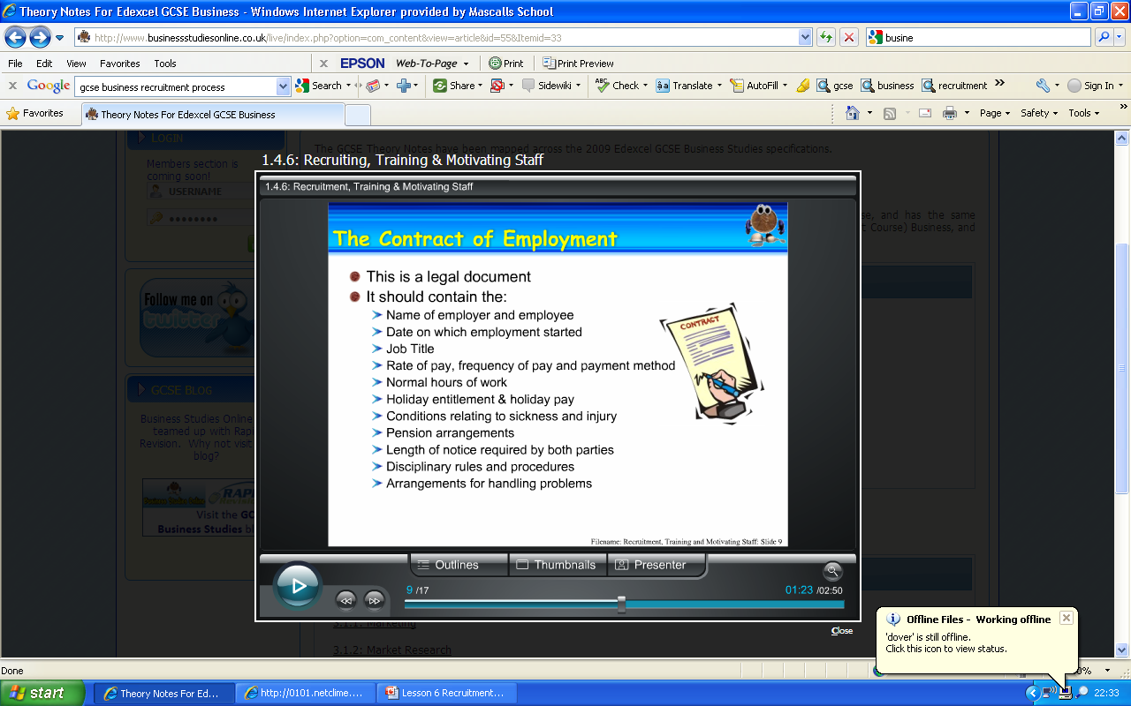
The Contract of Employment

Slide 22
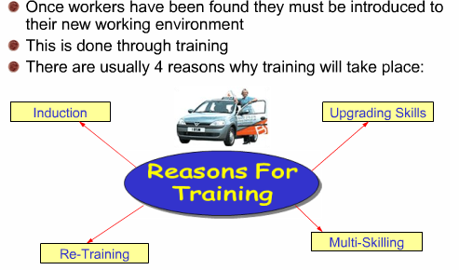
Training

Slide 23
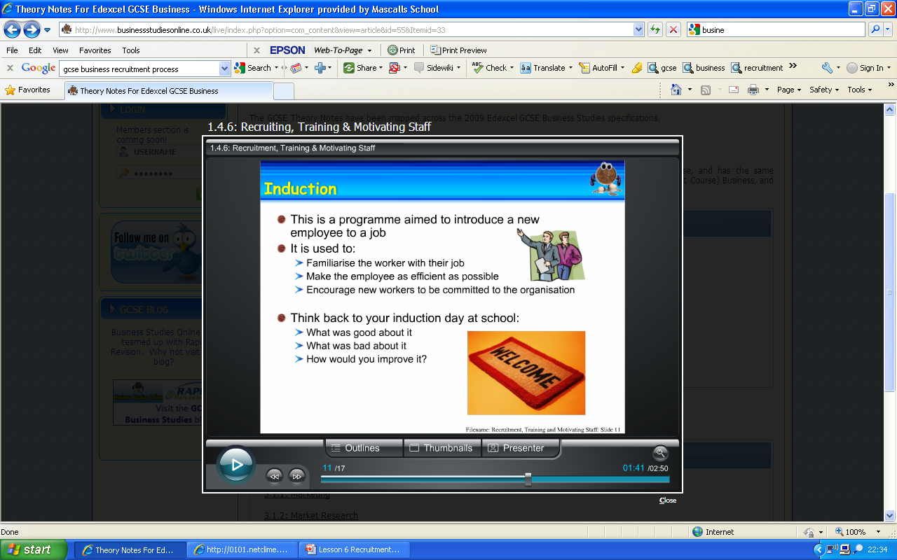
Induction

Slide 24
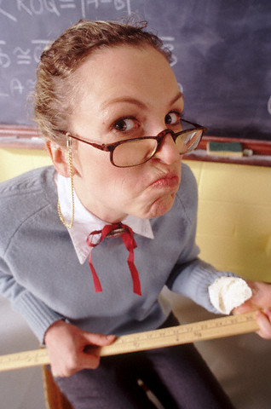
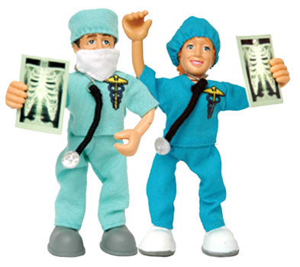
Training methods
Small businesses tend to use ON-THE-JOB TRAINING. This is where a worker remains at their usual place of work and learns how to do their job.
Examples:
Doctors & Teachers

Slide 25
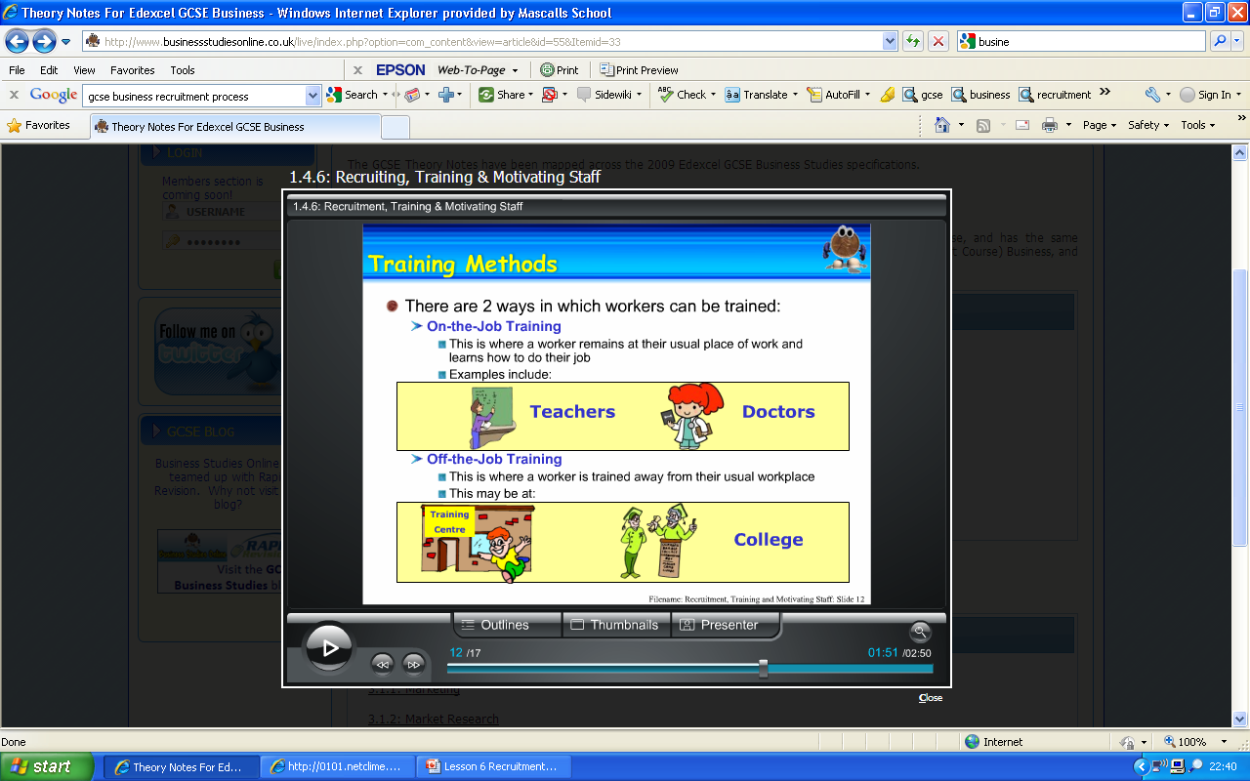
Training methods
Larger businesses tend to use OFF-THE-JOB TRAINING.
Can you think of any examples?

Slide 26


Skills versus attitude
What’s more important?
Lets debate!

Slide 27
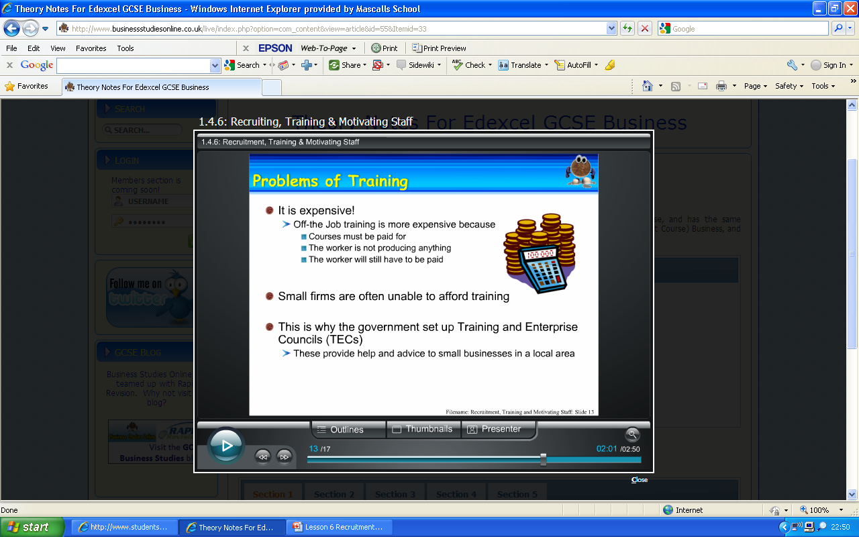
Problems with training staff

Slide 28

Key Employment Legislation
Race Relations Act
Sex Discrimination Act
Disability Discrimination Act
Employment Equality (Age) Regulations
Equal Pay Act
Employment Protection Act
TASK: In your groups, discuss how these laws may impact on employers and employees.

Slide 29
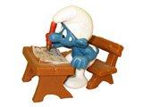
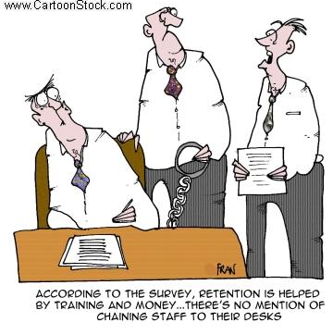
Training Task
Complete the training worksheet
-20 minutes -

Slide 30

Plenary: Give me a minute...
In your groups, consider all the aspects of
training that we have covered today.
2. Each group will be given ‘a minute’ to talk about the topic.
3. Choose one person to start the discussion – they are in control of the microphone. When the teacher says next, the next member of the group must continue the discussion picking up where the previous student left off. So Listen Up, it’s a team challenge!

