Slide 1
Class : Y11
Lesson Topic: Finance
Scheme of Work: Working Capital

Slide 2
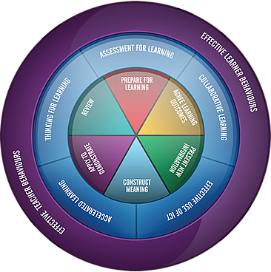

Slide 3
Lesson Objectives
P&D
Planning and
Data
Define and describe working capital .
Examine and Analyse the working capital cycle.
Evaluate the pros and cons & Justify your views on methods to improve the working capital.
Higher thinking Skills

Slide 4
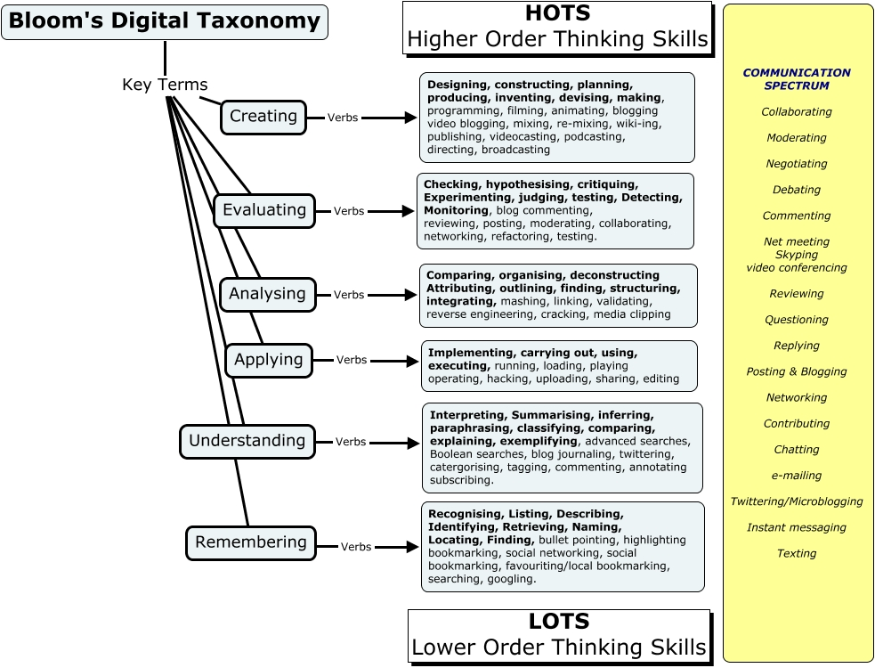
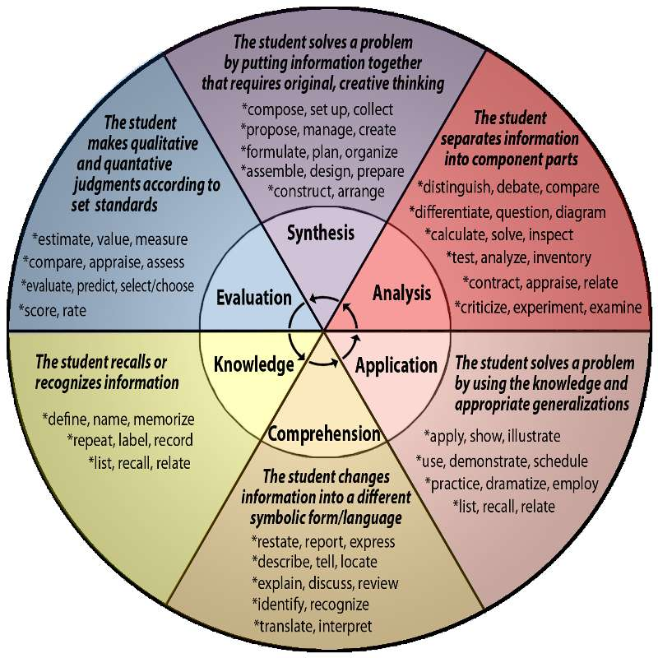
Planning Tools
P&D
Planning and
Data

Slide 5
Keyword | Definition
Working capital
Working capital cycle
Current assets | The liquid assets of a business e.g cash and stock
Current liabilities | The money owed by a business which must be paid within a year
CONNECTIVES

Slide 6
CONTRASTING
Although… Except…
Moreover… If…
However… Yet…
Apart from… Unless…
Despite… As long as…
COMPARING
Equally…
As with…
Like…
In the same way…
Similarly…
Even so…
Likewise…
QUALIFYING
Despite… Yet…
As long as… Unless…
Apart from… If…
Moreover… Except…
However… Although…
CAUSE & EFFECT
Consequently… Due to…
As a result… Therefore..
Because of… Because…
CONNECTIVES for Analysis
CONNECTIVES for Application
CONNECTIVES for Evaluation
ADDING
In addition… And…
Too… Also…
Additionally… As well as…
Furthermore…
CONCLUDING
Firstly… After…
Secondly… Before…
Overall… I believe…
Finally… I think …
In conclusion… it depends…
To conclude… short term…
Meanwhile… Long term…
EMPHASISING
Most importantly…
Significantly…
Notably…
Especially…
Above all…
In particular…
Indeed…
ILLUSTRATING
For instance… Such as…
In the case of… So…
For example…
As revealed by…
As illustrated by…

Slide 7
Climb the Ladder
ATD
Apply to
demonstrate
A-A* | To what extent Do you think Evaluate whether (8-10m) 10+ connectives & key words
C-B | Explain Compare Analyse (5-8m) 5+ connectives & key words
E-D | Define Describe Identify (2-4m) 2 + connectives & key words

Slide 8
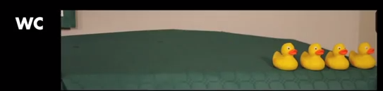
Videos
http://www.investopedia.com/video/play/working-capital/
https://www.youtube.com/watch?v=7JBwhhrwUCk
What is working capital ?
How does the Duck Shop manage working capital?

Slide 9
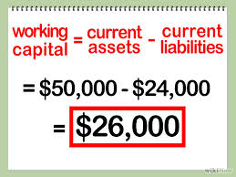
Working Capital
.
  Working capital =
  current assets - current liabilities
  2- 1 (ideal)

Slide 10
WC Problems
Buying too many fixed assets: When a business first starts trading, money is short. Buying expensive assets such as equipment and vehicle uses up cash.
Unexpected Expenditure: Businesses may have to meet some unforeseen expenditure e.g. Equipment breakdowns and strikes.
Unexpected fall in demand: Working Capital may decline if sales start to fall due to an unexpected fall in demand of products/services. E.g. Due to a new competitor entering the market.
Seasonal factors: Sometimes demand changes for seasonal reasons. E.g. Farmers have a large cash inflow when their harvest is sold but for most of the year they have no cash inflow yet many expenses.

Slide 11
Methods of Improving WC
Get an overdraft or a short-term loan to cover cash shortages.
Get some fresh capital: E.G use personal savings or take out a loan, or sell shares.
Sell Goods for Cash: E.g. offer discounts/sales to encourage people to buy products/services.
Delay Payments: Get a longer Trade Credit Period from suppliers

Slide 12
Definitions Test 8/10/15
Overdraft
Trade Credit
Dividend
Mortgage
Gearing
Hire Purchase
Retained Profit
Working Capital
Current Liabilities
Government Grant

Slide 13
Climb the Ladder
ATD
Apply to
demonstrate
A-A* | To what extent Do you think Evaluate whether (8-10m) 10+ connectives & key words
C-B | Explain Compare Analyse (5-8m) 5+ connectives & key words
E-D | Define Describe Identify (2-4m) 2 + connectives & key words

Slide 14

Pass the Parcel
R
Review the Learning
Add as much information you can remember from today’s lesson
When the horn blows – pass your sheet to the next table!

Slide 15

Neighbours
R
Review the Learning
2 things your neighbour has learnt today
1 question your neighbour wants to ask

Slide 16

Tweet Tweet
R
Review the Learning
Summarise your learning today into a single tweet
140 characters
Keep all of the information
STOP

Slide 17
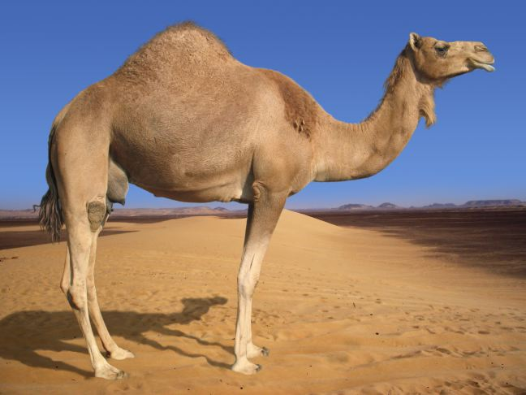
1
question
you need to ask
2 new things you learnt
3 pieces of information
R
Review the Learning

Slide 18
5 minutes. . . GO
STOP

